Slide 2

Oracle Database 12c Multitenant Architecture

Slide 3
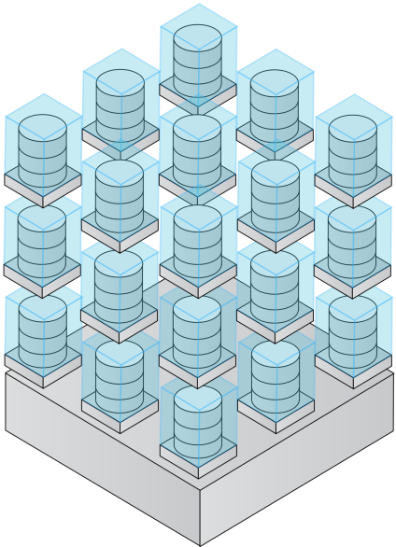
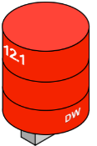
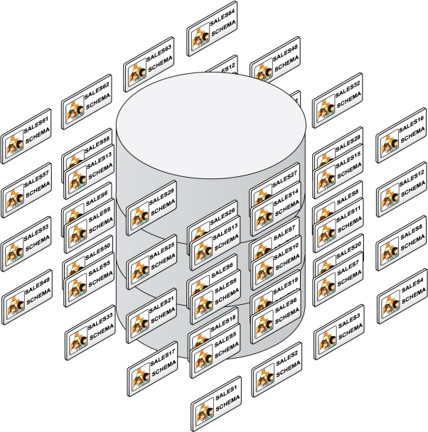

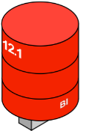
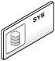
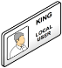

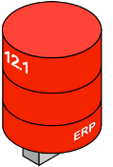
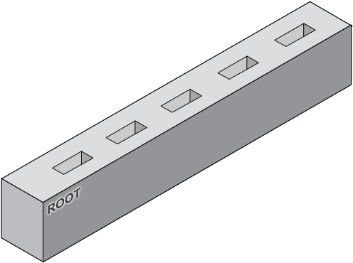

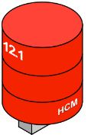

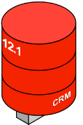
Database Cloud & Consolidation Architectures
Virtual Machines
Multiple DB Instances
Schema Consolidation
NEW DB 12c Multitenant
Share servers
with
“VM isolation”
Share servers and OS with
“DB Instance Isolation”
Share servers, OS and database with
“Schema Isolation”
Share servers, OS
and database with
“Pluggable DB Isolation”

Slide 4
The need for Database Consolidation Why?
Customers have 100s or 1000s of databases across their enterprise
They want to lower costs by operating these databases on a centrally managed platform
With only hardware consolidation, each database has an overhead, that prevents 100s of database from being placed on the same physical server

Slide 5
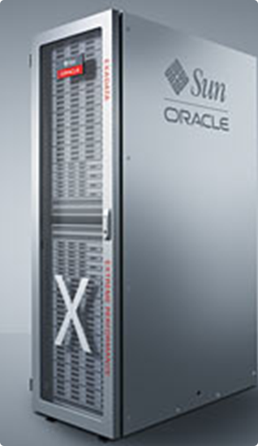

Database Consolidation Requirements
No change to applications
No performance degradation
Centralized resource management
Isolation between environments
Simplify patching and upgrades
ERP
CRM
BI
DW

Slide 6

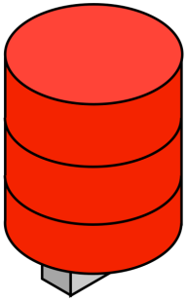
Consolidating Databases on Clouds
Key requirements…
No application changes
Isolation and multitenancy
Fast provisioning and cloning
12.1
Secure and highly available
12.1
12.1
Lower IT costs
Manage many as one
Greater resource utilization
Performant and scalable

Slide 7
Multitenant Architecture + Pluggable Databases
Oracle Database 12c lets you have many pluggable databases (PDBs) in a single multitenant container database (CDB)
PDBs share common resources
The application connects to the PDB and sees it just like a pre-12c database
The system administrator connects to the CDB as a whole and sees a single system image

Slide 8






Oracle Database Architecture
Each Databases requires memory, processes and database files
System Resources
Database
Files
Database
Files
Database
Files
Background
Processes
Background
Processes
Background
Processes
ERP
CRM
DW
Memory
Memory
Memory

Slide 9





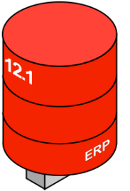
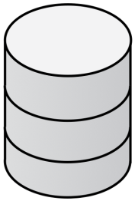
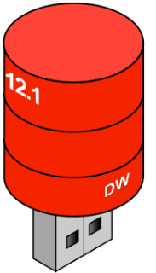
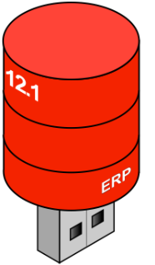
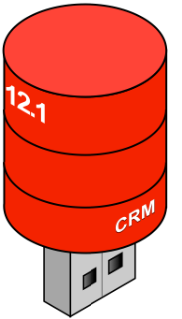


New Multitenant Architecture
Memory and processes required at container level only
System Resources
Database
Files
Database
Files
Database
Files
Background
Processes
Background
Processes
Background
Processes
ERP
CRM
DW
Container Database
Memory
Memory
Memory

Slide 10
New Multitenant Architecture
Memory and processes shared and managed at container level
System Resources
Container Database

Slide 11
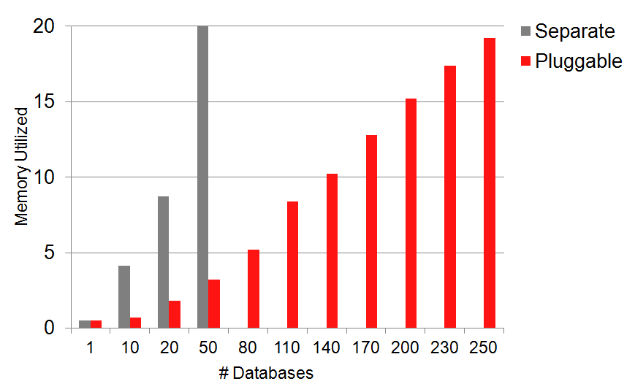
Pluggable vs Separate Databases Highly Efficient: 6x Less H/W Resource, 5x more Scalable
OLTP benchmark comparison
Only 3GB of memory vs. 20GB memory used for 50 databases
Pluggable databases scaled to over 250 while separate database instances maxed at 50

Slide 12

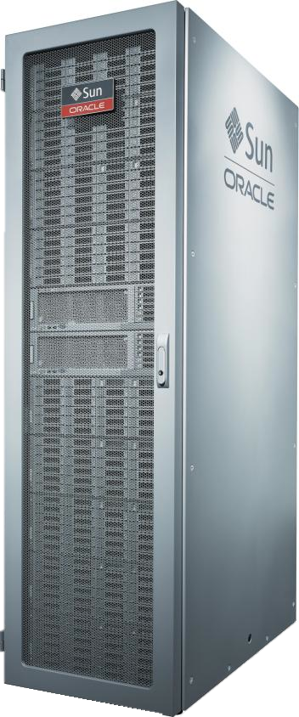



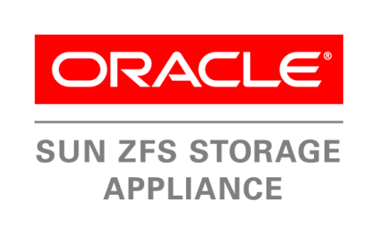
Manage Many Databases as One
Backup databases as one, recover at pluggable database Level
12.1
One Backup
DW
12.1
CRM
12.1
ERP
Container Database
Point-in-time recovery
at pluggable database level

Slide 13




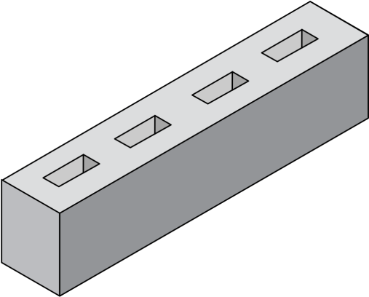


Manage Many Databases as One
One standby database covers all pluggable databases
12.1
12.1
12.1
HCM
HCM
12.1
12.1
DW
12.1
DW
12.1
CRM
12.1
CRM
ERP
ERP
Production Container Database
Standby Container Database

Slide 14
Simplified Patching
Apply changes once, all pluggable databases updated
12.1
12.X
DW
12.1
12.X
CRM
12.1
12.X
ERP
Container Database
Upgrade in-place

Slide 15
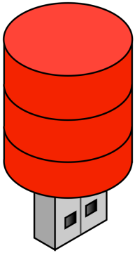
Simplified Upgrades
Flexible choice when patching & upgrading databases
12.1
DW
12.1
12.X
CRM
DW
12.1
12.X
ERP
CRM
Original Container Database (12.1)
Upgraded Container Database (12.X)

Slide 16
Oracle Database 12c Multitenant Architecture Benefits
Reduced TCO
Administrative costs
Operational costs
Data Center costs
Storage costs
Contingency costs
Improved …
Resource utilization
Manageability
Service Management
ERP
CRM
BI
DW

Slide 17
Oracle Database 12c Alternative Architectures
Business Value | Many databases on one machine | Many databases as schemas in one database | Many databases as PDBs in one CDB
Implementation | Easy | Difficult* | Easy
Isolation | Highest | Limited | High
Availability | High | Highest | Highest
Scalability | Limited | High | High
Performance | Low | High | High
Resource management | Fair | Severely limited | Excellent
ROI | Low | High | Highest
* Need to validate application schemas can co-exist
Notes:
17
All provide fast provisioning

Slide 18
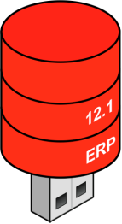
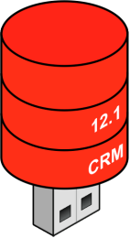
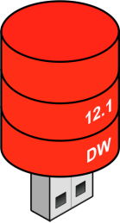
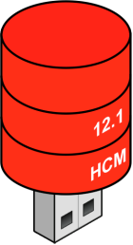
Multitenant Architecture
Components of a Multitenant Container Database (CDB)
PDBs
12.1
12.1
12.1
HCM
12.1
DW
Root
12.1
CRM
Pluggable Databases (PDBs)
ERP
ROOT
CDB
Multitenant Container Database
Notes:
Let’s look at the components of a multitenant container database
We have the pluggable databases or PDBs
There are two parts to the term pluggable databases;
There’s “pluggable”, which is new and “databases” which is familiar.
Before we get to the revolutionary new stuff let’s discuss what hasn’t changed.
A pluggable database is a fully functional self-contained Oracle database. It’s not watered down in any way.
From the perspective of an application or an end user it hasn’t changed at all.
This is very important because it means that no application changes are required to adopt this new architecture.
[click]
We introduce a new concept: a root database
[click]
Into which are plugged various PDBs
[click]
And the combination is referred to as a multitenant container database or CDB

Slide 19
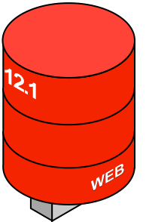
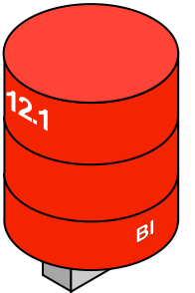
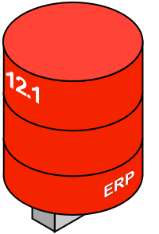
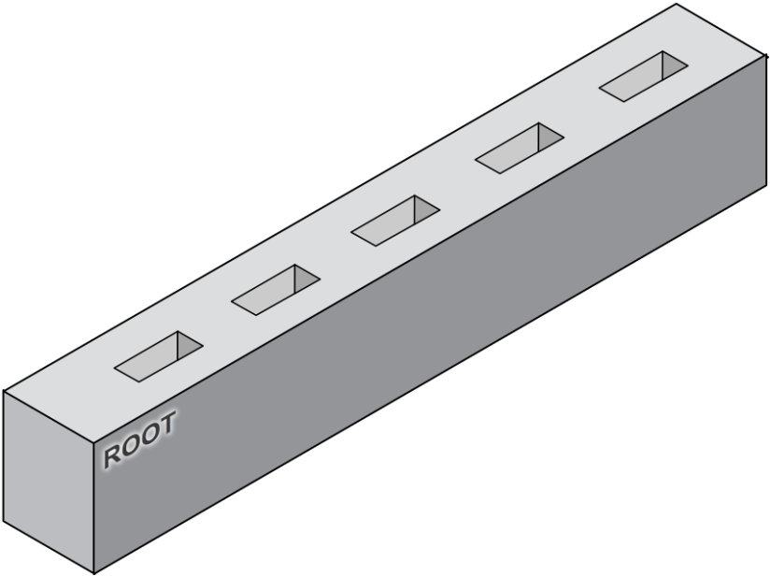
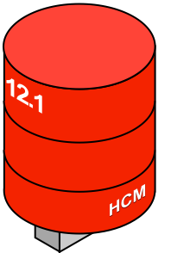
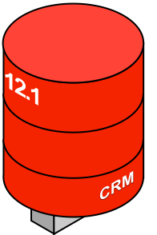
Multitenant Architecture
Multitenant architecture can currently support up to 252 PDBs
A PDB feels and operates identically to a non-CDB
You cannot tell, from the viewpoint of a connected client, if you’re using a PDB or a non-CDB
Database Link
Notes:
Read slide.
…for example, for a user connected to the CRM PDB to access data in the HCM PDB, he would have to do so using a database link, just as was the case with prior versions of the database.

Slide 20
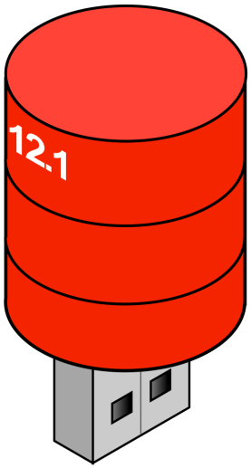
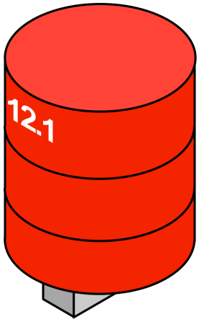
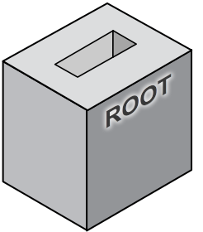
Unplug / plug
Simply unplug from the old CDB…
Notes:
Now what if we wanted to move a PDB from one container
[click]
to another?
With Oracle Multitenant, we can simply
[click]
Unplug it from the first
[click]

Slide 21
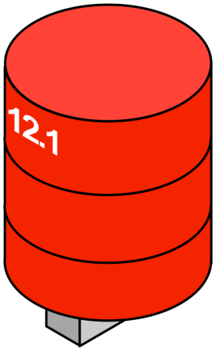
Unplug / plug
…and plug in to the new CDB…
Moving between CDBs is a simple case of moving a PDB’s metadata
An unplugged PDB carries with it lineage, opatch, encryption key info etc
Notes:
And plug it into the second container.
Read slide.

Slide 22
Unplug / plug
Example
Unplug
alter pluggable database HCM
unplug into '/u01/app/oracle/oradata/…/hcm.xml'
Plug
create pluggable database My_PDB
using '/u01/app/oracle/oradata/…/hcm.xml'
Notes:
Now, all of this is achieved via SQL.
Here, for example we see two SQL statements that would be used first to unplug a PDB
And then to plug in a PDB
Notice that the manifest of the unplugged PDB is specified as an xml file.

Slide 23
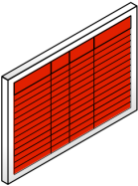
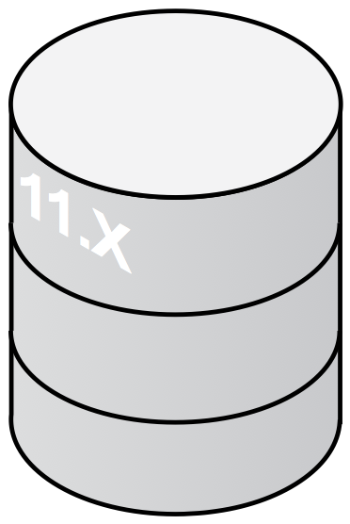
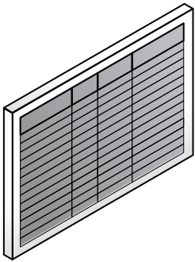
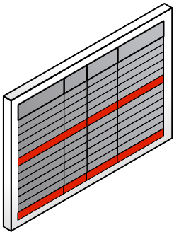
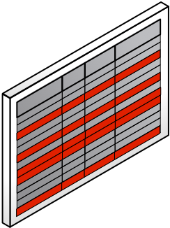
Common Data Dictionary
Before 12.1: dilution over time
Database Created
Tables, Code, Data added
Mature Database
Notes:
Now, what did we have to change to be able to achieve this vision?
Let’s discuss what happens to a traditional Oracle database over time.
Here we need to distinguish between two parts of the database – the data dictionary and the user data.
When the database is first created, the only tables present are the Oracle data dictionary tables.
The only data they contain is the Oracle-supplied meta data for the database, such as the definitions of the Oracle data dictionary tables themselves, their columns, etc.
[click]
Now, as the user schema is added to the database, the definitions of these user tables, columns, indexes, etc are also stored in the data dictionary.
[click]
So, over time in a mature database, the data dictionary contains Oracle-supplied meta data of the Oracle data dictionary intermingled with the definitions of the user’s application schema.
That’s been fine until now, but it’s an obstacle to our new goal of being able to unplug an application-database and move it from one container to another.

Slide 24
Oracle Data and User Data
Multitenant fix: Horizontally-partitioned data dictionary
Only Oracle system definition remains
Data dictionary is diluted by customer’s metadata
OBJ$
OBJ$
OBJ$
TAB$
TAB$
TAB$
SOURCE$
SOURCE$
SOURCE$
EMP
DEPT
…
…
…
…
Notes:
Here’s another view of the same situation.
In the pink box on the right we see the user data
In the grey box on the left we see the data dictionary.
The Oracle-supplied meta data is represented by the grey rows
And the meta data for the user application schema is represented by the red rows.
In the old architecture, there they were, all mixed up together.
If you do a query on the data dictionary, it will typically return rows from both the Oracle-supplied meta data and the meta data for the user’s schema.
[click]
In the new multitenant architecture, we separate all the user data into a self-contained “pluggable” database
Containing both the user tables and data
And a data dictionary containing the definition of the user schema or application back-end if you like.
The root database contains
*only* the Oracle data dictionary tables, containing
*only* the Oracle-supplied meta data.
We refer to this as a horizontally partitioned data dictionary.

Slide 25
Horizontally Partitioned Data Dictionary
Oracle-supplied objects such as views, PL/SQL, etc., are shared across all PDBs using object “stubs”
In-database virtualization
OBJ$
TAB$
SOURCE$
EMP
DEPT
…
…
OBJ$
TAB$
SOURCE$
…
Notes:
Read slide.
So just as before, if you do a query on the data dictionary of the PDB,
it will still return rows from both the Oracle-supplied meta data and the meta data for the user’s schema.
It is this horizontally-partitioned data dictionary that allows us the portability via pluggability of the PDBs.

Slide 26
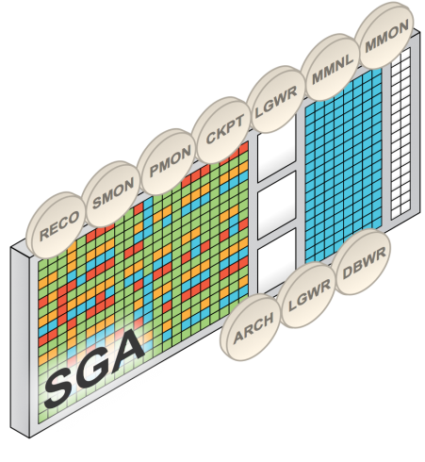


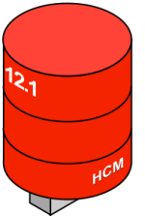

Multitenant Architecture – Dynamics
PDBs share common SGA and background processes
Foreground sessions see only the PDB they connect to
Notes:
The multitenant container database behaves as a single database from the operations point of view.
We only have a single set of Oracle background processes and a single, shared database memory requirement for the entire CDB,
Shared across all PDBs plugged into it.
This gives us very high consolidation density; in other words more applications per server.
This affords maximum reduction in capital expenses.

Slide 27


Multitenant Scalability
Only small increments in memory as additional PDBs are added
Notes:
Here we see a CDB with three PDBs plugged into it.
In the graph we see that when the first PDB was plugged in, the CDB required about 2BG to run.
The next couple of PDBs plugged in required only a little bit more
[click]
And each additional PDB requires just a small increment in memory
[click] as it’s plugged in.
Again, this is because all PDBs share the same overheads of memory and background processes, managed commonly across the entire CDB.

Slide 28
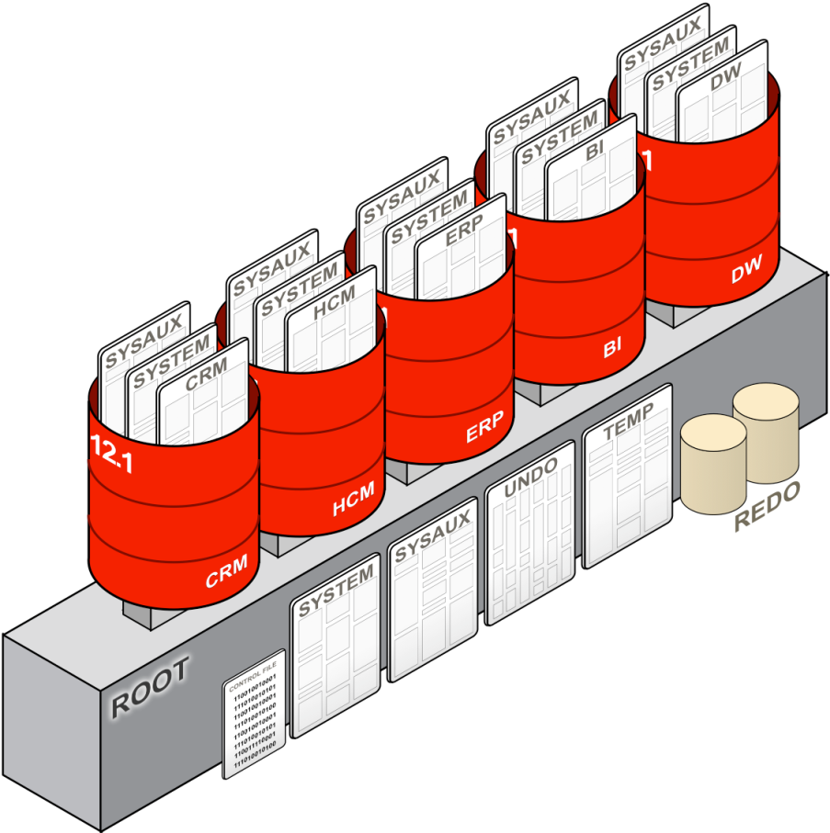
Files in the CDB
Namespaces
Each PDB has its own set of tablespaces including SYSTEM and SYSAUX
PDBs share UNDO, REDO and control files, (s)pfile
By default the CDB has a single TEMP tablespace but PDBs may create their own

Slide 29
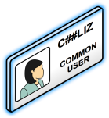
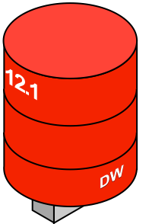
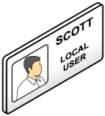
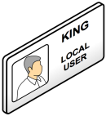
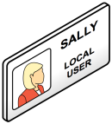
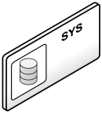




Users
Local users are the successors for customer-created users in a non-CDB
A local user is defined only in a PDB
A local user can administer a PDB
A common user is defined in the root and is represented in every PDB
A common user can log into any PDB where it has “Create Session” and can therefore administer a PDB
The Oracle system is owned by common users

Slide 30
Common Users and Privileges
Authorization is checked in the same way as as pre-12.1
A common user can be granted privileges locally in a PDB (or root) and therefore differently in each container
A common user can, alternatively, be granted a system privilege commonly – the grant is made in root and every PDB, present and future
You can create a common role
A common role can be granted to a common user commonly
Authorization is checked in the container where the SQL is attempted considering only the privileges that the user has in that container

Slide 31

New Multitenant Architecture for Consolidating Databases
No application changes
Isolation and multitenancy
Fast provisioning and cloning
Secure and highly available
Lower IT costs
Manage many as one
Greater resource utilization
Performant and scalable

Slide 32
Pluggable Database
A PDB feels and operates identically to a non-CDB Database
You cannot tell, from the viewpoint of a connected client, if you’re using a PDB or a non-CDB Database
A new PDB can be created in seconds

Slide 33
Pluggable Database
Simply unplug…
Moving between CDBs is a simple case of moving a PDBs metadata
PDBs can be moved using
SQL Developer
Enterprise Manager 12c
SQL commands
Database Configuration Assistant (DBCA)

Slide 34
Pluggable Databases
And if you can have one…
The Pluggable Databases architecture can currently support up to 252 PDBs in a single CDB Database
You can utilize Database Links between PDBs and between PDBs and non-CDB databases
Database Link
Notes:
Waiting on confirmation from Bryn

Slide 35

Shared Resources
Background processes
Shared/process memory
Oracle metadata
Control files
Redo Log files

Slide 36
Files in PDBs
Each PDB has its own set of tablespaces including SYSTEM and SYSAUX
PDBs share UNDO, REDO and control files
By default the CDB has a single TEMP tablespace, but PDBs may create their own

Slide 37
Users
PDB Users are the successors for users in a non-CDB
Local users can administer PDBs
A special class of users “Common Users” has the same identity in all PDBs
Common users can log into any database they have “create session” privilege for
Common users own the Oracle system
PDBs can be administered by a common user, too

Slide 38


Application Express in Oracle Database 12c Multitenant Architecture

Slide 39


Standard “Default” 12c Installation
Application Express 4.2 installed in CDB (Container DB)
Local Tables
(APEX meta-data for *that* PDB)
PDB Seed
APEX_040200
APEX_040200
APEX_040200
APEX_040200
Meta-data Links
Views, Packages, Functions, Procedures
Root
APEX_040200 Schema
APEX 4.2 is installed into CDB$Root and PDB$Seed
Each PDB contains meta-data linked objects to APEX Schema in Root
Each PDB also has an APEX Schema which holds local tables

Slide 40
Standard 12c Installation
Creating a new PDB from seed
Local Tables
(APEX meta-data for *that* PDB)
PDB Seed
APEX_040200
APEX_040200
APEX_040200
APEX_040200
APEX_040200
Root
APEX_040200 Schema
Meta-data Link
PDBs created by copying PDB$Seed
New PDB includes Local Tables and Meta-data links to Root objects
Web Listener *must* be configured for each PDB {each with unique port}

Slide 41
Removing Common Application Express
Uninstalling Application Express 4.2 from the CDB
PDB Seed
No APEX
No APEX
No APEX
No
APEX
No
APEX
APEX_040200
APEX_040200
APEX_040200
APEX_040200
Root
APEX_040200 Schema
Post-installation run apxremov_con.sql* to remove from CDB, PDB Seed and all PDB’s {*DB Patch 16946990 required}
All existing APEX meta-data within all of the PDBs will be removed

Slide 42
Non-Standard Configuration
Installing Different Versions into PDBs
PDB Seed
No APEX
No APEX
No
APEX
No
APEX
APEX_
040200
APEX_
050000
No APEX
APEX_040200
APEX_040200
APEX_040200
APEX_040200
Root
APEX_040200 Schema
Uninstall Application Express from the CDB
Log into PDB, run apexins.sql or apxrtins.sql
Can install different versions of APEX (> Release 4.2) into any PDB

Slide 43
Re-Installing into Root Database
Application Express 4.2 *removed* and then reinstalled into CDB
PDB Seed
APEX_ 040200 Runtime
APEX_ 040200 Runtime
APEX_ 040200 Runtime
APEX_ 040200 Runtime
APEX_ 040200 Runtime
No
APEX
No APEX
No APEX
No APEX
APEX_ 040200
APEX_ 040200
APEX_ 040200
APEX_ 040200
Root
APEX_040200 Schema
APEX_040200 Runtime Schema
Uninstall Application Express from the CDB
Run script apexins_con.sql or apxrtins_con.sql
Use this technique to install runtime only Application Express in CDB
Installs in Root, PDB$Seed and all PDBs, also creates meta-data links

Slide 44



Migrating from Oracle Database 11g to PDB
Upgrade 11g database to 12.1 in place
Place the non-CDB into read only mode
Connect to non-CDB and generate an XML Metadata file
Shutdown the non-CDB
Plug in non-CDB to CDB
Run noncdb_to_pdb.sql → Replaces local APEX_040200 schema objects with meta-data linked objects {If APEX configured in CDB$Root}
Notes:
Script noncdb_to_pdb.sql is available in $ORACLE_HOME/bin

Slide 45
Moving/Copying PDBs Between 12c Databases
From APEX IN CDB$Root → APEX IN CDB$Root
APEX_040200
APEX_040200
APEX_040200
APEX_040200
APEX_040200
Root
APEX_040200 Schema
Root
APEX_040200 Schema
Move / copy PDB
Configure Web Listener for new PDB {Must specify a unique port}

Slide 46
Moving/Copying PDBs Between 12c Databases
From APEX NOT IN CDB$Root → APEX IN CDB$Root
APEX_
040200
APEX_
040200
APEX_
040200
APEX_040200
APEX_040200
Root
Root
APEX_040200 Schema
Move / copy PDB (…)
Application Express installed differently in source and target databases

Slide 47
Moving/Copying PDBs Between 12c Databases
From APEX NOT IN CDB$Root → APEX IN CDB$Root
APEX_
040200
APEX_
040200
APEX_
040200
APEX_
040200
APEX_040200
APEX_040200
APEX_040200
Root
Root
APEX_040200 Schema
Run apex_to_common.sql in PDB to create meta-data links
Configure Web Listener for new PDB

Slide 48
Moving/Copying PDBs Between 12c Databases
No APEX → APEX IN CDB$Root
APEX_
040200
APEX_040200
APEX_040200
Root
Root
APEX_040200 Schema
Run apexins.sql on PDB while in Source database (…)
Need to install before moving as can’t be installed into PDB when in Root

Slide 49
Moving/Copying PDBs Between 12c Databases
No APEX → APEX IN CDB$Root
APEX_
040200
APEX_
040200
APEX_040200
APEX_040200
Root
Root
APEX_040200 Schema
Move / copy PDB (…)
Now that Application Express is in source database it is ready to move

Slide 50
Moving/Copying PDBs Between 12c Databases
No APEX → APEX IN CDB$Root
APEX_
040200
APEX_
040200
APEX_040200
APEX_040200
APEX_040200
Root
Root
APEX_040200 Schema
Run apex_to_common.sql in PDB to create meta-data links
Configure Web Listener for new PDB

Slide 51
Moving/Copying PDBs Between 12c Databases
From APEX NOT IN CDB$Root → APEX NOT IN CDB$Root
APEX_
040200
APEX_
040200
Root
Root
Move / copy PDB
Configure Web Listener for new PDB

Slide 52
Moving/Copying PDBs Between 12c Databases
From APEX IN CDB$Root → APEX NOT IN CDB$Root
APEX_
040200
APEX_
040200
APEX_040200
APEX_040200
APEX_040200
X
Root
APEX_040200 Schema
Root
Contact Oracle Support
Special version specific apex_to_local.sql scripts available

Slide 53
Moving/Copying PDBs Between 12c Databases
Incompatible Versions: Higher Release → Lower Release (x > y)
APEX_xxxxxx
APEX_xxxxxx
APEX_xxxxxx
APEX_yyyyyy
APEX_yyyyyy
APEX_xxxxxx
APEX_xxxxxx
Root
APEX_xxxxxx Schema
Root
APEX_yyyyyy Schema
APEX_xxxxxx Schema
Run apxpatch_con.sql or apexins_con.sql in target CDB to upgrade CDB Root to be the same as the source
Move / copy PDB {Perform other steps, such as configure Web Listener}

Slide 54
Moving/Copying PDBs Between 12c Databases
Incompatible Versions: Lower Release → Higher Release (x < y)
APEX_xxxxxx
APEX_xxxxxx
APEX_xxxxxx
APEX_yyyyyy
APEX_yyyyyy
APEX_yyyyyy
Root
APEX_xxxxxx Schema
Root
APEX_yyyyyy Schema
Move / copy PDB
Run catcon.pl in new PDB to upgrade to the same release as in the target CDB Root installation {See Installation Guide for syntax}

Slide 55
Upgrading / Patching Application Express
APEX IN CDB$Root versus APEX NOT IN CDB$Root
APEX_040200
APEX_040200
APEX_
040200
{4.2.0}
APEX_
040200
{4.2.2}
Root
APEX_040200 Schema
Root
Run container scripts, such as apexins_con.sql, in CDB
Perform update / patch ONCE for CDB and all PDBs
Run standard scripts, such as apexins.sql, in PDBs
Perform update / patch on EACH PDB separately & independently

Slide 56
Oracle Database 12c New Features
Important to
Application Express Developers

Slide 57
New Feature - Varchar2 32K
12c Database Parameter – max_string_size
STANDARD [Default] = 4000 byte/character limit (Pre-12c behavior)
EXTENDED = 32767 byte/character limit
After changing parameter must bounce database
Can specify textfield or textarea sizes up to 32K (32767)
Can run /core/collection_member_resize.sql to change collection VARCHAR2 columns from 4000 characters to 32767 characters

Slide 58
New Feature - Default | Default On Null
Default values are utilized when inserting a record if column not specified in the insert statement
With ON NULL will use default even if specified in the insert statement
If you specify a value explicitly it will not use default
Avoids the need for trigger logic

Slide 59
New Feature - Identity Column
Use Identity Columns instead of specifying a Sequence and using triggers / processes to retrieve the next value from the sequence
ALWAYS [Default] – Uses the sequence generator
BY DEFAULT – Can explicitly assign a specified value
BY DEFAULT ON NULL – Can explicitly assign, but uses sequence if evaluates to NULL
SQL Workshop → Can specify Identity in Create Table Wizard
Create Form / Report Wizard → Creates correct item type {display only}

Slide 60
New Feature - Invisible Column
Invisible columns are *user specified* hidden columns
SELECT * → Won’t display invisible columns
INSERT INTO x VALUES→ Won’t insert values in invisible columns
Must explicitly specify invisible columns to include them
SQL Workshop → Not shown in Object Browser, Query Builder, etc.
Create Form / Report Wizards → Columns won’t be shown
Must manually add to Source within APEX Region (post-generation) to view in Reports, etc.

Slide 61


New Feature - Limiting Rows from SQL Query
FETCH returns top ‘N’ records
Can specify rows or percentage,
Can include OFFSET to skip specified number of rows
Respects ORDER BY clause

Slide 62




New Feature - Data Redaction
Mask Application Data Dynamically
Policy enforced redaction of sensitive data
Payroll Processing
Call Center Operator
Soc. Sec. #
115-69-3428
DOB 11/06/71
PIN 5623

Slide 63

Proof Point - ARIA People
1st “Production” application on Oracle Database 12c
Written in Application Express
Used by virtually every employee in Oracle
>1.3 million page views / day
> 60 page views / sec
Median execution time 0.05 seconds

Slide 64
Industry Today
Pressures | Requirements
Increase Agility | Performance, scalability
Reduce Costs Capital Costs Operating Costs | Reliability, availability
Non-stop operations | Security, tenant isolation
DBA challenges: Patching, upgrades Provisioning | No application changes
Pressures
Increase Agility
Reduce Costs Capital Costs Operating Costs
Non-stop operations
DBA challenges: Patching, upgrades Provisioning
Pressures | Requirements | Trends
Increase Agility | Performance, scalability | Private Cloud
Reduce Costs Capital Costs Operating Costs | Reliability, availability | Massively Powerful Servers (Exadata)
Non-stop operations | Security, tenant isolation | Virtualization
DBA challenges: Patching, upgrades Provisioning | No application changes | Simplification Standardized Services Self-Service
Notes:
We always start by talking to our customers about the pressures and challenges they’re facing and what trends they’re seeing in the industry.
Some things don’t change. They face the same pressures and the same requirements as ever:
Pressure to do more with less; be faster, leaner, cheaper, and deliver services 24/7. Big companies have achieved scale. Now they want to realize economies of scale.
As ever, DBAs are faced with the challenges of patching and upgrading large numbers of databases, and provisioning new ones.
[click]
Requirements are familiar: PSR & HA are non-negotiable. Security in threatening climate. No time to stop and retool with new applications.
[click]
The trends are what is new. These are the techniques to use to respond to these pressures within the constraints of the requirements.
With the advent of cloud computing and availability of massively powerful servers – even engineered systems such as Exadata - our customers want to consolidate many applications into fewer larger servers.
There’s a move to standardized services – even self-service.

Slide 65

Manage Many as One with Multitenant
Backup databases as one; recover at pluggable database level
12.1
One Backup
DW
12.1
CRM
12.1
ERP
Multitenant Container Database
Point-in-time recovery
At pluggable database level
Notes:
By managing many as one, we maximize OpEx reduction.
Here we see a single backup strategy for the entire container database
… with the granularity of a PITR capability at the individual PDB level.

Slide 66
Manage Many as One with Multitenant
One standby database covers all pluggable databases
12.1
12.1
12.1
HCM
HCM
12.1
12.1
DW
12.1
DW
12.1
CRM
12.1
CRM
ERP
ERP
Production Container Database
Standby Container Database
Notes:
High Availability – standby database maintained by Active Data Guard.
Plug in a new PDB into the production CDB
[click]
And you have a corresponding PDB in the standby
Transactions in the new PDB are replicated to the standby automatically,
just by virtue of plugging that PDB into the CDB in this Active Data Guard environment.

Slide 67
Multitenant for Simplified Patching
Apply changes once, all pluggable databases updated
12.1
12.X
DW
12.1
12.X
CRM
12.1
12.X
ERP
Multitenant Container Database
Upgrade in-place
Notes:
Another example of managing many as one with Oracle Multitenant is upgrading or patching.
Patches and upgrades are applied at the multitenant container database level.
[click]
All PDBs in that CDB are automatically upgraded in one fell swoop.

Slide 68
Multitenant for Upgrades
Flexible choice when patching & upgrading databases
12.1
DW
12.1
12.X
CRM
DW
12.1
12.X
ERP
CRM
Original Container Database (12.1)
Upgraded Container Database (12.X)
Notes:
But if you want the granularity of a per-PDB upgrade, it can be done by unplug/plug into a second CDB, upgraded to the required level.
So applications can be upgraded as and when they’re ready.
[click]
In this example, ERP never moves to 12.x.
So, along with the advantages of managing many as one,
we’re beginning to see examples of the agility afforded by the new multitenant architecture.

Slide 69














Improved Agility With Changing Workloads
Expand Cluster to Support Flexible Consolidation Model
Node1
Node2
Services
CDB Instance 1
CDB Instance 2
Single SGA per
CDB Instance
DW
BI
CRM
HCM
ERP
Multitenant Container Database (CDB)
Notes:
This is another example.
Here we see an Oracle RAC environment, with two nodes in the cluster.
Notice that only certain PDBs are open on certain nodes of the cluster.
This is achieved by opening the corresponding services on these nodes as appropriate.
In this way we are partitioning the SGA across the various nodes of the RAC cluster.
This allows us to achieve great scalability on RAC.
At this peak stage of the business cycle, the system is running close to capacity as represented by the little resource meters.
It would be nice to add some processing power to this environment to handle this increased load.
[click]
We can do this by simply dropping another node into the cluster. [click]

Slide 70
Improved Agility With Changing Workloads
Expand Cluster to Support Flexible Consolidation Model
Node1
Node3
Node2
Services
CDB Instance 1
CDB Instance 3
CDB Instance 2
Single SGA per
CDB Instance
DW
BI
CRM
HCM
ERP
Multitenant Container Database (CDB)
Notes:
And then spreading the processing of the various database loads out across the expanded cluster.
Look at those little resource meters now – that’s a more comfortable load on the system.
Multitenant plays well with RAC. It’s a symbiotic relationship.
Multitenant makes RAC better and RAC makes Multitenant better.

Slide 71



Unprecedented Agility with Pluggable Portability
PDB migrates through SLAs as it becomes more mission critical
GOLD
RAC, Data Guard, Daily Incrementals
SILVER
Data Guard, Daily Incrementals
BRONZE
Weekly Full Backups
Notes:
Another great example of the agility we can achieve with Multitenant is changing service level agreements – SLAs – for individual PDBs.
In this environment we see three SLAs; bronze, silver and gold.
Our little PDB begins life in the bronze SLA environment, protected by weekly full backups.
It becomes more important and we want to move it to Silver, with Data Guard and daily incremental backups.
[click]
We simply unplug it from the CDB being managed at the Bronze SLA and plug it into the Silver SLA CDB.
As before we see the corresponding PDB in the standby database being automatically replicated.
[click]
As our PDB becomes even more mission critical we can just as easily move it to the Gold SLA PDB, with RAC in the mix.
Compare this with some of the earlier-generation consolidation models:
With dedicated databases we’d need to setup new backup procedures for this database.
With schema consolidation we can manage many as one but there’s no agility.

Slide 72


Multitenant for Fast Provisioning Pluggable databases can be quickly provisioned from seed
Notes:
The need to provision databases is a constant challenge for DBAs.
Creating a new database in the old non-CDB architecture was quite a slow process.
With Multitenant, creating a new PDB doesn’t take long at all.
[click]
Technically what’s happening is that we’re creating a copy – a clone – of a special empty PDB called the Seed.
In fact, on copy-on-write file systems such as ASM Clustered File System or ZFS, creating a new PDB is extremely fast – just a couple of seconds.

Slide 73
Multitenant for Provisioning
Fast cloning of PDBs
PDBs can be cloned from within the same CDB
PDBs can be cloned from remote CDBs
Notes:
The same cloning approach can be used to copy existing application databases.
Again, where the underlying file system supports copy-on-write we can create snapshot clones – extremely fast.
[click]
PDBs can be cloned from within the same CDB
[click]
And PDBs can be cloned from remote CDBs.
NOTE: A bug prevents remote clone from being used in 12.1.0.1. We hope that the fix will be included in 12.1.0.2.

Slide 74
Cloning a PDB
Example
Local
create pluggable database HCMBI from HCM
Remote (DB Link)
create pluggable database HCMBI from HCM@us.acme.db1
Notes:
As before, cloning is performed by using SQL.
Here are the SQL statements to create a local clone…
And to clone a PDB in a remote container, we need to specify the database link.

Slide 75
Per PDB vs per CDB
Common operations on CDB with granular control where appropriate
Per CDB
Per PDB
Single Oracle Software Version
Data Guard
Scheduled RMAN Backups
Some parameters/properties e.g. homogeneous character set
Redo and Undo
RMAN point-in-time recovery
Ad hoc RMAN backups
Flush shared pool
Parameters where IsPDB_Modifiable = 'TRUE'
Notes:
We’ve seen that we can achieve great reductions in operating expenses by managing many as one.
We have carefully selected the operations that can be performed at the level of the overall multitenant container database.
Here are some prominent examples.
Read slide
But we retain granular control where appropriate.
[click]
The sort of operations we still want to perform at the level of the individual PDBs are
Read slide

Slide 76


Advantages of Multitenant Architecture
Reduced CapEx & OpEx, Increased Agility, Easy Adoption
Self-contained PDB for each application
Applications run unchanged
Rapid provisioning (via clones)
Portability (via pluggability)
Shared memory and background processes
More applications per server
Container Database
Common operations performed at CDB level
Manage many as one (upgrade, HA, backup)
Granular control when appropriate
Notes:
Read slide
[click]
[click]

Slide 77
Agenda
Rethinking Architecture for the Database Cloud
Multitenant Architecture
Capabilities Enabled
Managing Shared Resources
Upgrading to Multitenant
Use Cases
Notes:
Now that we’re able to consolidate multiple applications into a single database we need to think about how to share resources appropriately.
We don’t want any single application to run away with all the resources of the system at the expenses of everyone else.

Slide 78




Managing Shared Resources
Resource management in multitenant environment
DW
CRM
ERP
Low Priority
Medium Priority
Multitenant Container Database
High Priority
Notes:
This is a simplistic visualization of our high-level concept.
We have three PDBs with different processing priorities:
DW is low priority,
CRM is medium
& ERP is high priority.
[click]
When only DW is busy, why not let it use all the resources in the system.
As the demand of the higher priority CRM system picks up,
DW has to yield some of its processing resources.
And as the High priority ERP system kicks in, the other two have to back off significantly.
Let’s see how it works in more detail.
[This is an opportunity to describe how we can now support inter database Resource Management. The dials are simply showing that as higher priority workloads come on the lower priority ones release resources. We aren't being specific about the resource. It could be CPU or Parallel Query Servers. ]

Slide 79
Managing Resources between PDBs
Using Resource Manager, you can control
CPU
Exadata I/O
Sessions
Parallel execution servers
Configure a policy that controls how resources are utilized
Default configuration that works, even as PDBs are added or removed
Hard limits, for “get what you pay for”
Notes:
PDBs vie for shared resources
Using Resource Manager we can configure policies to control how these resources are shared.
We can control CPU, Parallel execution servers, Sessions and, in Exadata, I/O.
For example this would allow us to configure a policy so that the first tenant in a large, powerful server experiences a realistic share of the resources that will eventually be shared as other tenants are plugged in.

Slide 80
Managing Resources between PDBs
The model is “industry standard” based on two notions:
A number of shares is allocated to each PDB
A “cap” (a.k.a. maximum utilization limit) may be applied to each PDB
Notes:
Read slide

Slide 81



Manage CPU
A CDB Resource Plan uses shares to specify how CPU is distributed between PDBs
2 Shares
1 Share
1 Share
Pluggable Database | Shares | Guaranteed CPU | Maximum CPU
HCM | 2 | 2/4 = 50% | 100%
CRM | 1 | 1/4 = 25% | 100%
ERP | 1 | 1/4 = 25% | 100%
Notes:
Here’s an example of how we’d specify resource plans for the allocation of CPU between three PDBs
There are four total shares, 2 for HCM and one each for CRM and ERP.
That means that HCM is guaranteed 50% of the CPU whatever else is going on in other PDBs.
Similarly CRM and ERP are each guaranteed at least 25%.
However, there are no caps in this case, so that, for example, ERP could have 100% of the CPU if HCM and CRM were idle.

Slide 82
Agenda
Rethinking Architecture for the Database Cloud
Multitenant Architecture
Capabilities Enabled
Managing Shared Resources
Upgrading to Multitenant
Use Cases
Notes:
Now you’ve seen how wonderful Oracle Multitenant is, you’ll be eager to upgrade all your applications.
How do you do it?

Slide 83


Upgrading to Multitenant
Step 1: Upgrade databases in-place
Container Database
10.2
11.1
11.2
12.1
12.1
12.1
ERP
CRM
DW
ERP
CRM
DW
Container Database
Upgrade in Place
Notes:
I told you this architecture was easy to adopt. Easy as 1-2-3.
Step 1. Upgrade your existing databases in-place to version 12.1,
[click]
just as you’ve done upgrades to prior versions.

Slide 84




Upgrading to Multitenant
Step 2: Plug-in upgraded databases
12.1
12.1
12.1
ERP
CRM
DW
Container Database
Notes:
Step 2. Plug in the upgraded databases into a pre-prepared multitenant container database.
We call this process “adopting the database as a PDB”.

Slide 85
Upgrading to Multitenant
Step 3. Change applications to work with Multitenant
Step 3. Change applications to work with Multitenant
No application changes required.
Notes:
…and of course, step 3 is to change your applications to work with Multitenant.
[click]
Oh yes, that’s right! There is no step 3! No application changes are required to work with Oracle Multitenant!

Slide 86

Migrate using Replication
Provision new PDB from Seed
Replicate using technologies such as Oracle GoldenGate or Data Pump New in 12.1, you ask that full database export and full database import make maximum use of transportable tablespaces in the single expdb and impdb commands. (Backported to 11.2.0.3.)
Notes:
Another option is to upgrade using replication.
[click]
Simply provision a new, empty PDB.
[click]
Then, using Oracle Golden Gate or Data Pump, replicate the data from the source database to the new PDB.
[click]
This approach might be more appropriate for a database in a much older version of Oracle, where version-by-version upgrades would be too cumbersome.

Slide 87
Agenda
Rethinking Architecture for the Database Cloud
Multitenant Architecture
Capabilities Enabled
Managing Shared Resources
Upgrading to Multitenant
Use Cases
Notes:
Finally, let’s take a look at some of the major use cases for Oracle Multitenant.

Slide 88





1. Multitenant for Test and Development
Fast, flexible copy and snapshot of pluggable databases
12.1
ERP Dev Copy
DW
ERP Dev Copy
12.1
CRM
ERP Dev Copy
12.1
ERP
Production Container Database
Development Container Database
Notes:
Development and testing is a great place to start, for two reasons:
By definition it’s not a production environment.
The very people you’d want to become expert in this new technology before production deployment will be using it in their day-to-day operations.
The typical requirement is that individual need rapid provisioning and recycling of private copies of a few "master test databases”.
[click]
Here, the rapid provisioning via cloning – particularly snapshot cloning – capabilities of Oracle Multitenant make previously cumbersome operations extremely efficient.

Slide 89
2. Consolidation of Disparate Applications
Shared overhead of memory and processes
System Resources
Container Database
Notes:
A classic use case for Mutltenant is the consolidation of disparate applications.
These might be smaller, departmental applications typically cluttering up the data center with dedicated environments.
They’re disproportionately expensive to manage, or neglected, or both.
Great cost savings can be achieved by consolidating them on to fewer servers and managing many as one.

Slide 90








3. Self-Service Database as a Service (DBaaS)
Pick from standard sizes and service levels
GOLD
RAC, Data Guard, Daily Incrementals
SILVER
Data Guard
Daily Incrementals
✔
L
XL
BRONZE
Weekly Full Backups
XS
S
M
✔
Notes:
In Database-as-a-Service the typical requirement is self-service provisioning on the private database cloud.
Here’s a simplistic view of how this might work.
[click]
Select from a standard set of database sizes… in this case a medium one
[click]
Choose the appropriate SLA… let’s say Silver, with Data Guard and daily incremental backups
[click]
And an appropriately sized database is provisioned
And plugged in to the appropriate CDB

Slide 91

3. Self-Service Database as a Service (DBaaS)
Pick from standard sizes and service levels
GOLD
RAC, Data Guard, Daily Incrementals
✔
SILVER
Data Guard
Daily Incrementals
L
XL
BRONZE
Weekly Full Backups
XS
S
M
✔
Notes:
This slide plays automatically. Be patient. No clicking required.
Here we see another example
In this case we’re choosing a large database
To be managed at the Gold SLA – this time with RAC, along with Data Guard
And we see it being provisioned and plugged into the Gold SLA CDB.

Slide 92





4. Multitenant. Perfect for SaaS.
Multitenancy implemented by the Database, not the Application
CUST 7
CUST 6
CUST 5
CUST 4
CUST 3
CUST 2
CUST 1
Multitenant Container Database
Notes:
Multitenant is perfect for Software as a Service, or SaaS.
Here we implement multitenancy in the database, not the application.
Consider the requirements:
Data Isolation: Each Customer’s Data in Private Pluggable Database
Database Security: All Native Database Security features work: Encryption, Redaction …
Database Tools: All Native Query, Reporting, Business Intelligence Tools Work
None of this Works when Multitenanacy is Implemented at the Application Level
This provides an instant SaaS architecture for legacy applications

Slide 93



5. Multitenant. Perfect for ISVs.
Packaged apps and reference data are easily distributed
ERP
Ver. 2
ERP
Ver. 1.1
ERP
Ver. 1
ERP
Ver. 1
ISV Development Container Database
Customer Container Database (Cloud)
Notes:
Multitenant provides a great way for ISVs to create that all-important good first impression.
This is so easily spoiled by a cumbersome installation process with multiple steps…
(create schema, import seed data, import application code PL/SQL…)
How can we do it with Multitenant?
Simply clone the production version of the fresh application as a PDB
[click]
put it on a USB drive or something
Literally stick it in an envelope and ship it to the customer.
Maximum bandwidth!
The customer then simply plugs in this new PDB into their Multitenant Container Database
And voila! There’s the application up and running, ready to be used!

Slide 94
Use Cases
Development / Testing – start here!
Consolidation of Disparate Applications
Database as a Service (DBaaS) on Private Cloud
Software as a Service (SaaS)
ISVs: Distribution of Packaged Apps and Data
…many others!
Notes:
Review use cases.
Read slide

Slide 95
Oracle Multitenant
What customers are saying…
“Oracle Multitenant is a step forward in that it gives us more control over our schemas and applications; to be able to isolate them, give definitive statements on how performance is working and be able to manage more databases better.” Carfax
“With Oracle Database 12c, we can now copy an entire database from one instance to another using full transportable export/import. This minimizes the downtime when migrating clients’ databases.” Accenture
“Oracle Multitenant allows us to consolidate hundreds of databases onto a RAC environment that guarantees the separation that drove us to put them on separate servers previously.” Logical Technology
“Undoubtedly the number one most compelling feature of Oracle Database 12c is the support for consolidation. Oracle Multitenant can share memory resources, and make management easier because it is still a single database instance.” Pythian
Notes:
We are very proud of Oracle Multitenant and we’re excited about the ways it’s going to help our customers. So are they!
Here are some quotes from a few customers who are already using Oracle Multitenant.
Read…

Slide 96
Key Benefits
Benefit | Capability Enabled
Minimize CapEx | More applications per server
Minimize OpEx | Manage many as one Standardized procedures & service levels Rapid provisioning
Maximize Agility | Cloning for development / testing Portability through “pluggability” Scalability with RAC
Ease of Adoption | Applications run unchanged
Notes:
With traditional approaches to consolidation, there's typically been a tradeoff between reductions in capital expense or operating expenses, and it's always come at the cost of agility. With Oracle multitenant, we you can have your cake and eat it.
Minimize CapEx
More Applications per server
Minimize OpEx
Manage many as one
Standardized procedures and services
Rapid provisioning
Maximize Agility
Cloning for development and testing
Portability through pluggability
Scalability with RAC
Ease of Adoption
Applications run unchanged

Slide 97


